Slide 1
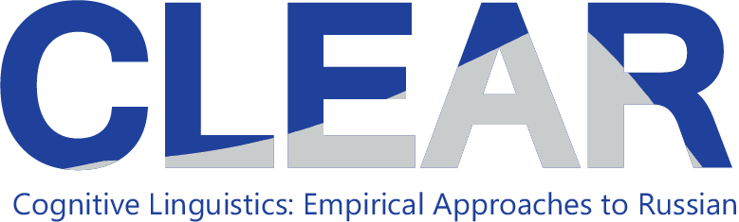
The Strategic Mastery of Russian Tool (SMARTool): A Usage-Based Approach to Acquiring Russian Vocabulary and Morphology
Laura A. Janda, UiT The Arctic University of Norway
Valentina Zhukova, Higher School of Economics, Moscow
Francis M. Tyers, Indiana University and Higher School of Economics, Moscow

Slide 2
Overview
Distributional Facts about Russian Paradigms
Computational Experiment on Learning of Paradigms
Introducing the SMARTool:
http://uit-no.github.io/smartool/

Slide 3
Distributional Facts about Russian Paradigms
Word frequency is inversely proportional to frequency rank (Zipf’s Law)
Zipfian distribution:
Few words of high frequency
Sharp decline
George K. Zipf

Slide 4
Zipf’s Law Applies to Wordforms
Language & Corpus Name | Corpus Size | Paradigm Size | Total Lexemes | Lexemes with full Paradigm | % Lexemes with full Paradigm
English Web Treebank | 254,830 | 2 | 6,369 | 1,524 | 23.92%
Norwegian Dependency Treebank | 311,277 | 4 | 12,587 | 393 | 3.12%
Russian SynTagRus | 1,032,644 | 12 | 21,945 | 13 | 0.06%
Czech Prague Dependency Treebank | 1,509,242 | 14 | 17,904 | 3 | 0.02%
Estonian ArborEst | 234,351 | 28 | 14,075 | 0 | 0%

Slide 5
Zipf’s Law Applies to Wordforms
Language & Corpus Name | Corpus Size | Paradigm Size | Total Lexemes | Lexemes with full Paradigm | % Lexemes with full Paradigm
English Web Treebank | 254,830 | 2 | 6,369 | 1,524 | 23.92%
Norwegian Dependency Treebank | 311,277 | 4 | 12,587 | 393 | 3.12%
Russian SynTagRus | 1,032,644 | 12 | 21,945 | 13 | 0.06%
Czech Prague Dependency Treebank | 1,509,242 | 14 | 17,904 | 3 | 0.02%
Estonian ArborEst | 234,351 | 28 | 14,075 | 0 | 0%
Because Zipf’s Law scales up, these numbers will never change substantially, no matter how large the corpus is

Slide 6
Language Exposure as a Big Corpus
A large corpus is a close approximation to the lifetime linguistic input for a native speaker, estimated at about 5-10 million words per year
Zipfian distributions remain the same even for very large corpora, like those that approximate a speaker’s exposure to their native language
A native speaker of Russian encounters all twelve paradigm forms of less than 0.1% of nouns that they are exposed to in a lifetime
The portion of adjectives and verbs attested in all paradigm forms is virtually zero.

Slide 7
Paradigm Cell Filling Problem (Ackerman et al. 2009)
Native speakers of languages with complex inflectional morphology routinely recognize and produce forms that they have never encountered.
Q: How is this possible?
A: Inflectional morphology is mastered through exposure to partially overlapping subsets of paradigms arranged according to Zipf’s Law , a cognitively plausible model

Slide 8
Frequency Distributions of Some High-frequency Russian Nouns
‘fear’ ‘soldier’ ‘department’ ‘concept’ ‘memory’
Nsg | страх | солдат | отделение | концепция | память
Gsg | страха | солдата | отделения | концепции | памяти
Dsg | страху | солдату | отделению | концепции | памяти
Asg | страх | солдата | отделение | концепцию | память
Isg | страхом | солдатом | отделением | концепцией | памятью
Lsg | страхе |  | отделении | концепции | памяти
Npl | страхи | солдаты | отделения
Gpl | страхов | солдат | отделений | концепций
Dpl |  | солдатам
Apl | страхи | солдат | отделения | концепции
Ipl | страхами |  | отделениями | концепциями
Lpl | страхах | солдатах | отделениях
Key: bold >20%, plain >10%, grey 1-9%, (blank) unattested

Slide 9
Masculine animates

Slide 10
Typically a lexeme is commonly found in only 1-3 wordforms
Masculine animates

Slide 11
Any single lexeme gives exposure to only a subset of the paradigm.
Each lexeme has a different subset of most typical forms.
Collectively they populate the entire “space” of case/number combinations.
Masculine animates

Slide 12
Distributional Facts about Russian Paradigms: Summary
Each lexeme is common in a subset of wordforms
Overlapping subsets of wordforms create the illusion of a full paradigm, make it possible for native speakers to comprehend and produce wordforms they have never encountered

Slide 13
Computational Leaning Experiment
Based on an ordered list of the most frequent forms for nouns, verbs, and adjectives in SynTagRus
Machine learning: training, testing
Given the 100 most frequent forms, predict the next 100 most frequent forms
Given the 200 most frequent forms, predict the next 100 most frequent forms
Given the 300 most frequent forms, predict the next 100 most frequent forms
… until 5400, when SynTagRus runs out of data
Testing is always: Predict paradigm forms for 100 previously unseen words
Two versions of experiment:
Training on entire paradigm, all forms
Training only on the single most frequent form

Slide 14
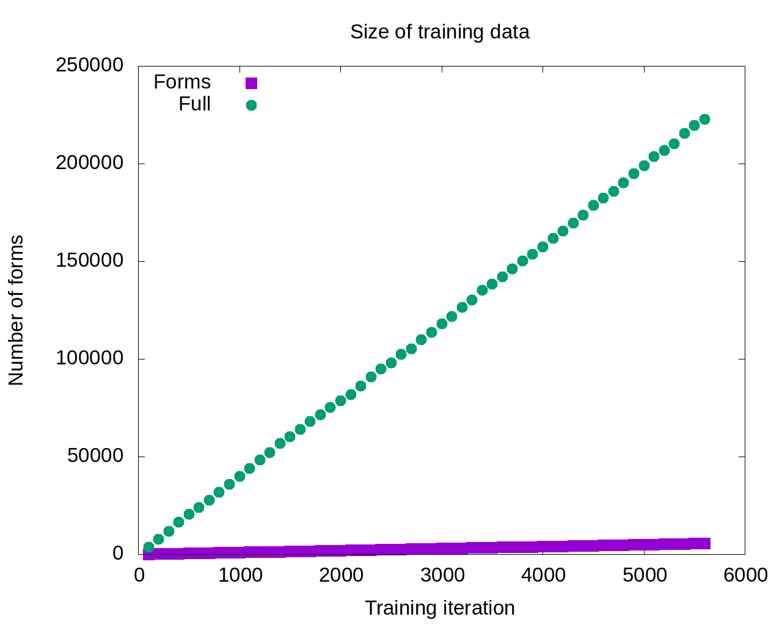

Slide 15
So the model that gets the most input should be the most successful, right?

Slide 16
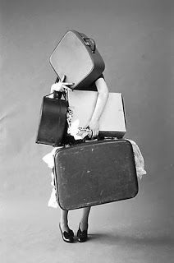
Maybe not…
So the model that gets the most input should be the most successful, right?

Slide 17
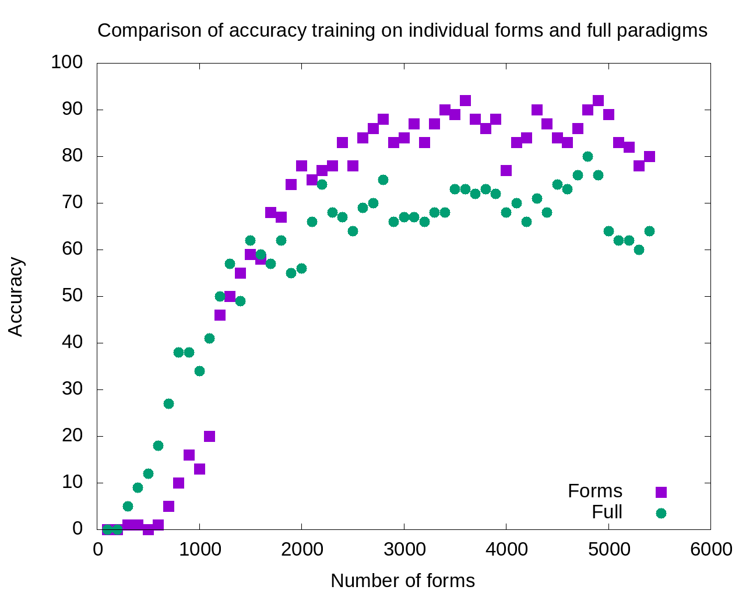
1800-5400:
Single forms model outperforms
full paradigms

Slide 18
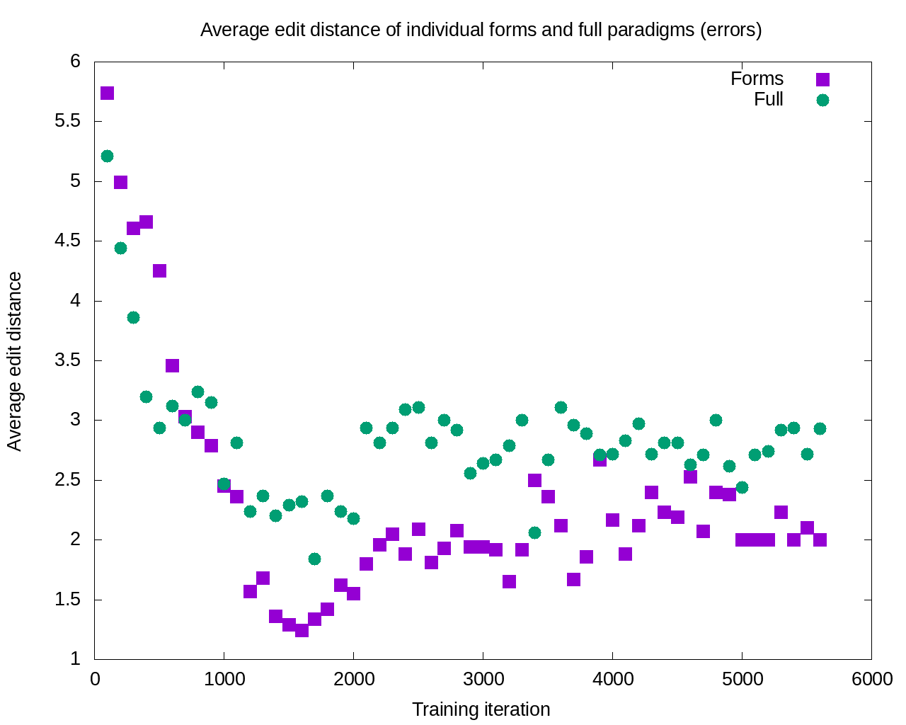
After 11 iterations, the errors committed by the single forms model are consistently smaller

Slide 19
Computational Learning Experiment: Summary
Learning is potentially enhanced by focus only on the most typical wordforms attested for each lexeme: accuracy increases and severity of errors decreases
This finding is consistent with a usage-based cognitively plausible model

Slide 20
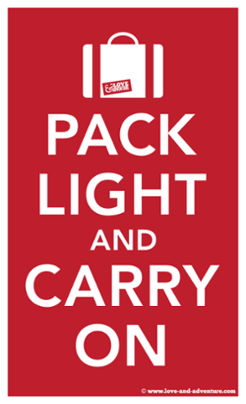
Introducing the SMARTool
Strategic Mastery of Russian Tool
The user can browse 3000 Russian words according to proficiency level, topic, and grammatical categories.
For each word, the SMARTool provides the three most common forms, plus example sentences that show typical collocations and grammatical constructions.

Slide 21
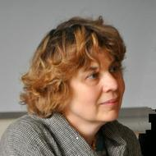
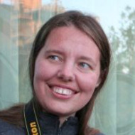
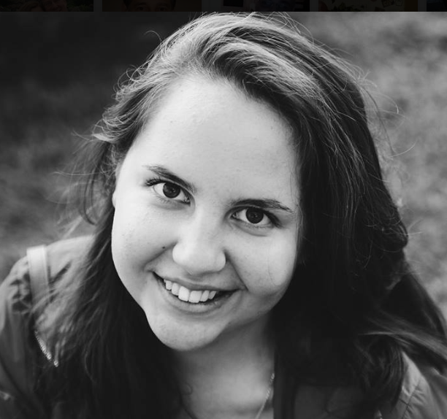
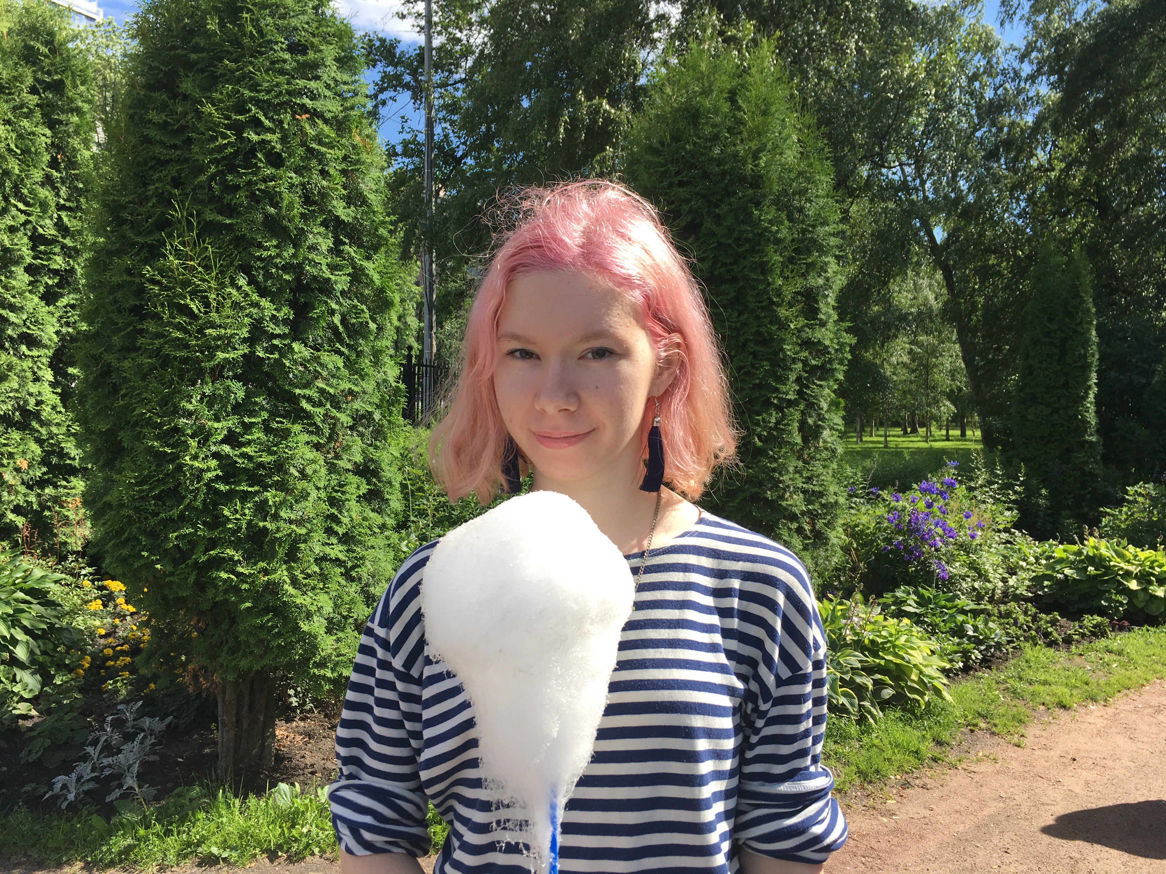
Members of the SMARTool team
Radovan Bast
Tore Nesset
Svetlana Sokolova
Mikhail Kopotev
Francis Tyers
Ekaterina Rakhilina
Olga Lyashevskaya
Valentina Zhukova
James McDonald
Evgeniia Sudarikova

Slide 22
Vocabulary Selection from 5 Textbooks and Лексический минимум; Balanced for Nouns, Verbs, Adjs (RNC ratio)
CEFR Level | ACTFL Equivalent | Russian Equivalent | SMARTool number of lexemes
A1 “Beginner” | Novice Low-Mid | ТЭУ Элементарный уровень | 500
A2 “Elementary” | Novice High | ТБУ Базовый уровень | 500
B1 “Intermediate” | Intermediate Low-Mid | ТРКИ-1 I Cертификационный уровень | 1,000
B2 “Upper Intermediate” | Intermediate High-Advanced Low | ТРКИ-2 | 1,000

Slide 23
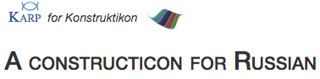
Typical Contexts Illustrated by Examples
For each lexeme we identify 3 most common wordforms and most typical grammatical constructions and lexical collocations, and provide corpus-inspired example sentences
Based on queries:
SynTagRus Corpus
the Russian National Corpus (http://ruscorpora.ru)
the Collocations Colligations Corpora (http://cococo.cosyco.ru/)
the Russian Constructicon (https://spraakbanken.gu.se/karp/#?mode=konstruktikon-rus)

Slide 24
SMARTool Filters
Select a level: A1, A2, B1, B2, all levels
Search by topic: внутренний мир, время, еда, животные/растения, жильё, здоровье, люди, магазин, мера, общение, одежда, описание, погода, политика, путешествие, свободное время, транспорт, учёба/работа
Search by analysis: Select grammatical features, such as “Ins.Sing”
Search by dictionary
Translations and audio available for all example sentences

Slide 25
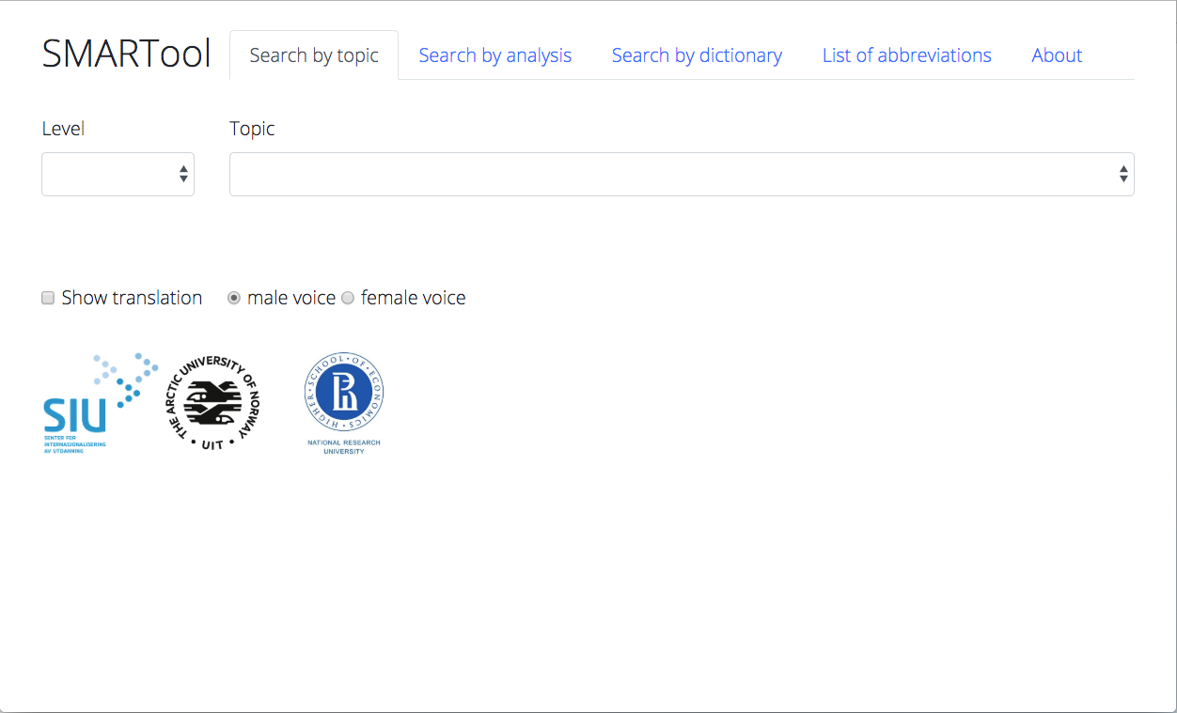
Select a Level
2) Search by topic, analysis, dictionary
Find the SMARTool here:
https://uit-no.github.io/smartool/

Slide 26
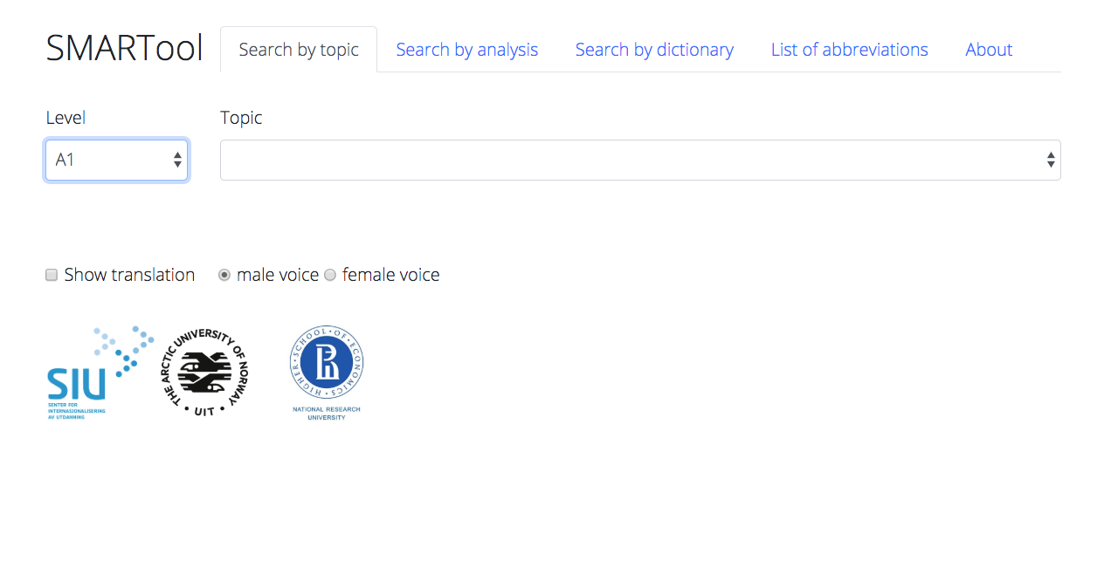

Slide 27
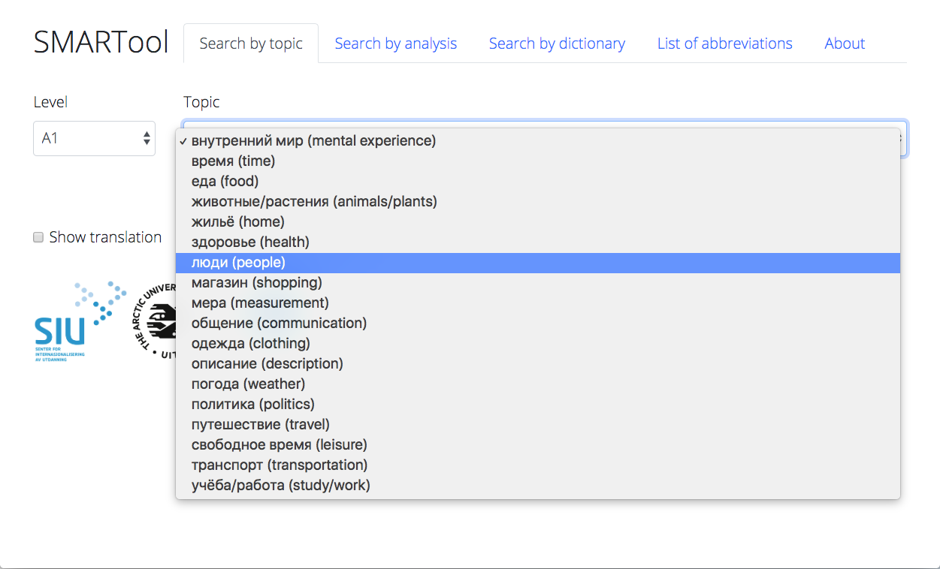

Slide 28
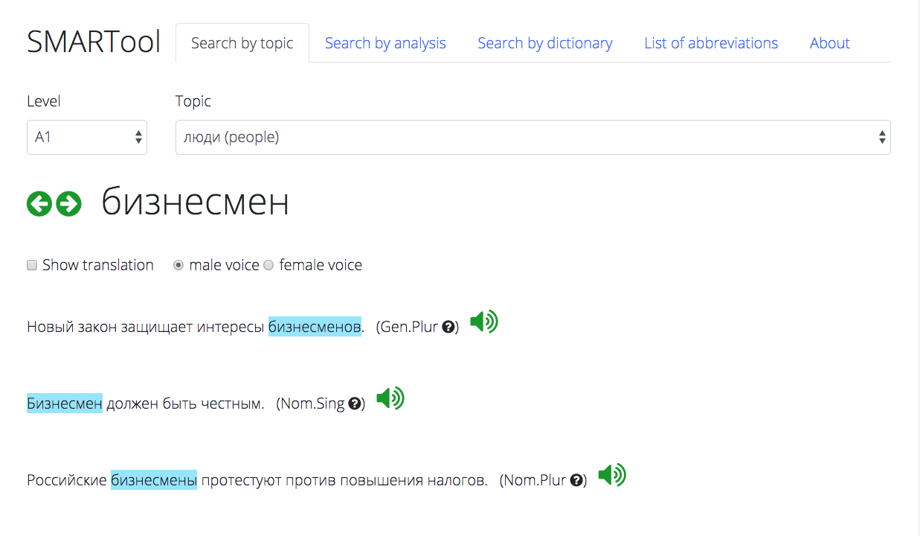

Slide 29
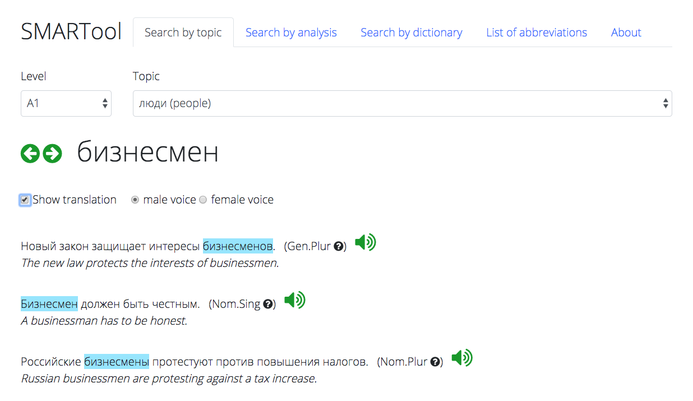

Slide 30
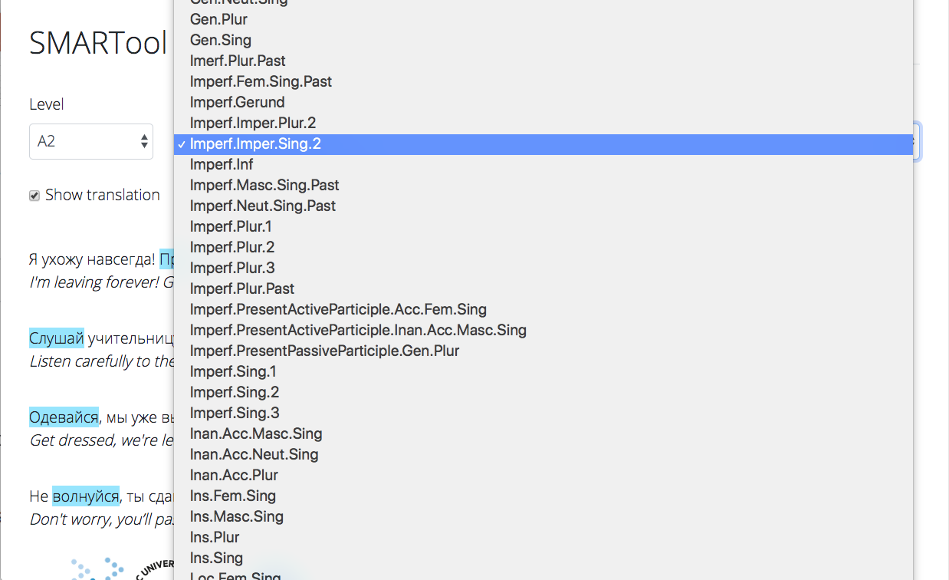

Slide 31
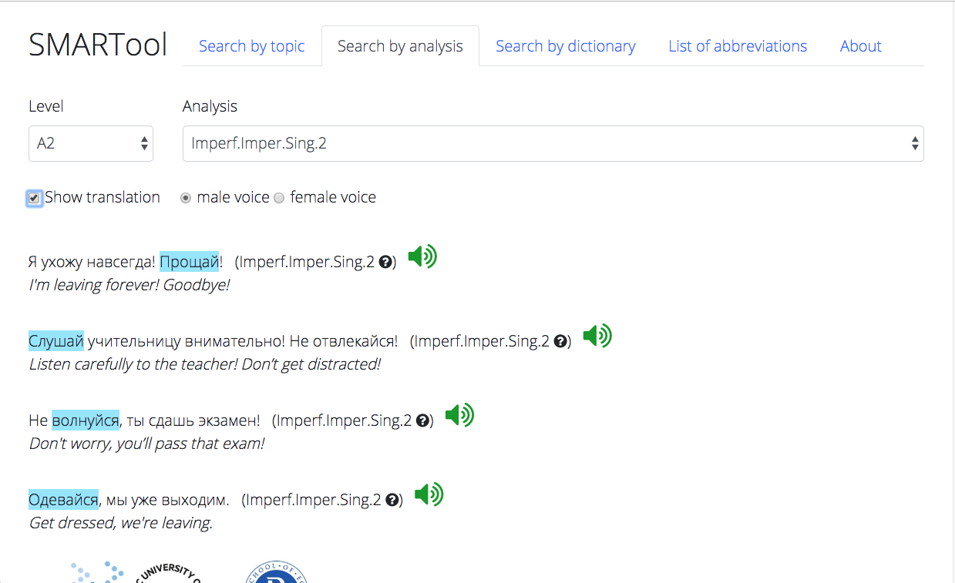

Slide 32
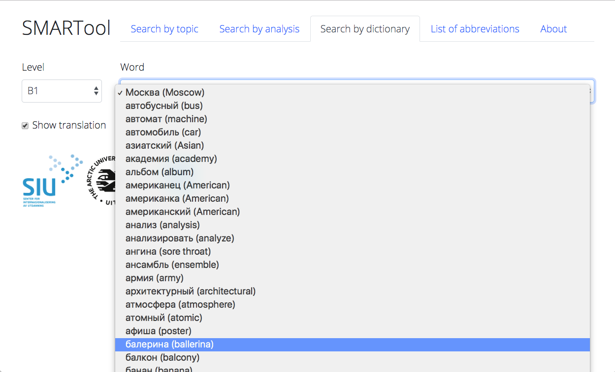

Slide 33
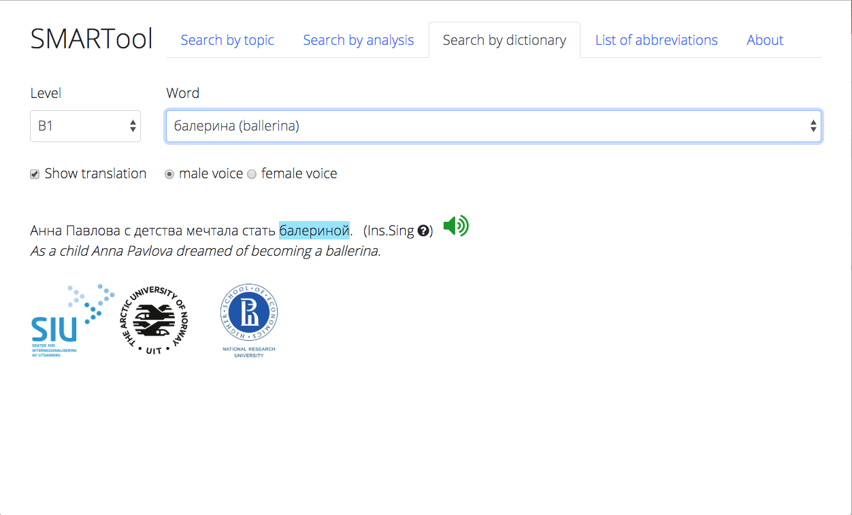

Slide 34
The SMARTool:
Inspired by research on the distribution and simulated learning of Russian wordforms (cognitively plausible)
Strategic focus on the highest frequency wordforms and contexts that motivate their use (usage-based)
Reduces the task of learning a basic vocabulary of about 3,000 lexemes by over 90%
Can be continuously updated and custom-tailored
Potentially portable to other languages with rich inflectional morphology

Slide 35
Future versions of the SMARTool
For Spanish- and Finnish-speaking learners of Russian
For learners of Polish and Czech

Slide 36
References
Andrjušina, N. P., G. A. Bitextina, L. P. Klobukova, L. N. Norejko, I. V. Odincova (eds.). 2014-2015. Лексический минимум по русскому языку как иностранному. Levels A1-B2. St. Petersburg: Zlatoust.
Baayen, R. Harald. 1992. Quantitative aspects of morphological productivity. In Gert E. Booij and J. Van Marle (eds.), Yearbook of Morphology 1991, 109–149. Dordrecht: Kluwer Academic Publishers.
Baayen, R. Harald. 1993. On frequency, transparency, and productivity. In Gert E. Booij and J. Van Marle (eds.), Yearbook of Morphology 1992, 181–208. Dordrecht: Kluwer Academic Publishers.
Bondar’, N. I. and S. A. Lutin. 2013. Как спросить? Как сказать?, 2nd ed. Moscow: Russkij jazyk.
Černyšov, Stanislav. 2004. Поехали! St. Petersburg: Zlatoust.
Chun, Dorothy, Richard Kern and Bryan Smith. 2016. Technology in language use, language teaching, and language learning. The Modern Language Journal, 100, 64–80. doi:10.1111/modl.12302
Comer, William. 2019. Measured words: Quantifying vocabulary exposure in beginning Russian. Slavic and East European Journal 60, no. 1, 92–114.
deBenedette, Lynne, William J. Comer, Alla Smyslova, Jonathan Perkins. 2013. Между нами (Between You and Me): An Interactive Introduction to Russian. http://www.mezhdunami.org/ (accessed 1 April 2018).
Djačenko, P. V., L. L. Iomdin, A. V. Lazurskij, L. G. Mitjušin, O. Ju. Podlesskaja, V. G. Sizov, T. I. Frolova, L. L. Cinman. 2015. Современное состояние глубоко аннотированного корпуса текстов русского языка (СинТагРус). Сборник «Национальный корпус русского языка: 10 лет проекту». Труды Института русского языка им. В.В. Виноградова. Вып. 6., 272–299.
Endresen, Anna, Laura A. Janda, Robert Reynolds and Francis M. Tyers. 2016. Who needs particles? A challenge to the classification of particles as a part of speech in Russian. Russian Linguistics 40: 2, 103-132. DOI 10.1007/s11185-016-9160-2.
Golonka, Ewa M., Anita R. Bowles, Victor M. Frank, Dorna L. Richardson, Suzanne Freynik. 2014. Technologies for foreign language learning: a review of technology types and their effectiveness. Computer Assisted Language Learning, 27:1, 70–105, DOI: 10.1080/09588221.2012.700315
Hart, Betty and Todd R Risley. 2003. The early catastrophe. The 30 million word gap by age 3. American Educator Spring 2003. 4–9.
Hayes-Harb, Rachel, Jane Hacking. 2015. The influence of written stress marks on native English speakers’ acquisition of Russian lexical stress contrasts. Slavic and East European Journal, 59:1, 91–109.
Hertz, Birgitte, Hanne Leervad, Henrik Lærkes, Henrik Møller, Peter Schousboe. 2001. Свидание в Петербурге. Møde i Petersborg. Copenhagen: Gyldendal.
Janda, Laura A. and Francis M. Tyers. 2018. Less is More: Why All Paradigms are Defective, and Why that is a Good Thing. Corpus Linguistics and Linguistic Theory 14(2), 33pp. doi.org/10.1515/cllt-2018-0031.
Janda, Laura A. Under Submission. Yggur and the power of language: A linguistic invention embedded in a Czech novel.
Kuznetsova, Julia. 2017. The ratio of unique word forms as a measure of creativity. In Anastasia Makarova, Stephen M. Dickey & Dagmar Divjak (eds.), Each Venture a New Beginning: Studies in Honor of Laura A. Janda, 85–97. Bloomington, IN: Slavica Publishers.
Malouf, Robert. 2016. Generating morphological paradigms with a recurrent neural network. San Diego Linguistic Papers. 6. 122–129.
Manning, Christopher D. & Hinrich Schütze. 1999. Foundations of Statistical Natural Language Processing. Cambridge, MA: MIT Press.
Moreno-Sánchez, Isabel, Francesc Font-Clos & Álvaro Corral. 2016. Large-scale analysis of Zipf’s Law in English texts. PLoS One. 11(1). e0147073. 10.1371/journal. pone.0147073.
Robin, Richard, Galina Shatalina, Karen Evans-Romaine. 2012. Голоса (Vols. 1-2), 5th ed. New York: Pearson.
Wade, Terence. 2011. A Comprehensive Russian Grammar, 3rd Edition. Oxford: Wiley-Blackwell.
Zaliznjak, A. A. 1980. Грамматический словарь русского языка. Moscow: Russkij jazyk.
Zipf, George K. 1949. Human Behavior and the Principle of Least Effort. Reading, MA: Addison-Wesley.

